Slide 1
LAB 5

Slide 2
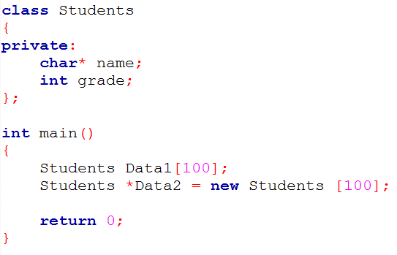
Class with one dimension

Slide 3
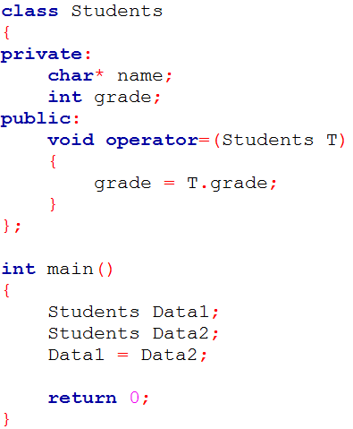
Operator =

Slide 4
Cstring
Strcpy
http://www.cplusplus.com/reference/cstring/strcpy/
Strcmp
http://www.cplusplus.com/reference/cstring/strcmp/
Cplusplus
http://www.cplusplus.com/

Slide 5
Lab5 Requirement
1. The format of zipcode is consist of three numbers
concatenated with hyphen concatenated with two numbers.
(ex.123-45)
2. Try to create users.
3. Every user has only one zipcode.
4. Users’ zipcode can be modified.
5. Show the registered user’s information included his name
and his zipcode.
6. Add the two different registered users’ zipcode and save it
as the first operand’s zipcode.(ex. There are two users, A and
B. You have to add these two users’ zipcode and save it as A’s
zipcode.)(You have to implement operator overloading ‘+’.)

Slide 6
Lab5 Requirement
7. Sum up the user’s zipcode and sort it from big to small.
(ex. There are 3 users, A, B ,and C. The zipcode of A is
111-11, the zipcode of B is 222-22, and the zipcode of C is
333-33. Then sum of A is 5, sum of B is 10, and sum of C is
15.Then sort all of the users you will get the sequence is
C>B>A.)

Slide 7
Lab5 Requirement
Command Format
Create New User
0
user name
Add Zipcode
1
user name
zipcode
Add two users’ zipcode and save it as the user1’s zipcode
2
user1
user2
Sum up and sort all of the existed users’ zipcode
3
Exit
4

Slide 8
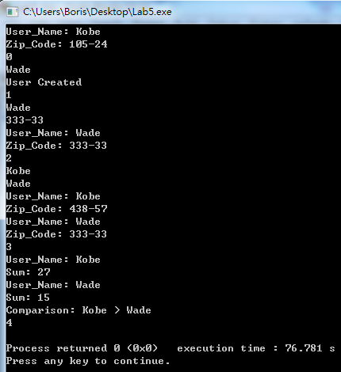
Lab5 Requirement
Sample I/O

